Slide 1
Entertainment Center Instructions
February 2018

Slide 2
Features
Smart 4K TV with Cable and Internet access
DVD Blu-ray Player
Wireless & Wired Microphones
CD Players with Karaoke or DJ
External Systems Connect
  Computer Display and Audio
  MP4 Music Player
  Other

Slide 3
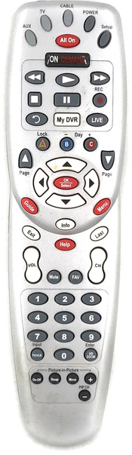
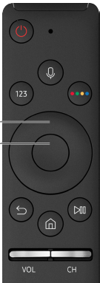
TV and DVD Control
TV button
Power
Power On TV
  Press Comcast remote TV button then Power Button
  Comcast box light goes on TV goes on
  If TV fails to go on Press TV remote power button
Power Off TV
  Press Comcast remote TV button then Power Button
  Comcast box light goes off TV goes off
  If TV fails to go off Press TV remote power button
To select TV source: Cable, DVD, Internet use TV remote
  Press menu button to open options at screen bottom
  Use left and right buttons to navigate, go left to Source
  When Sources appear above, press up button on remote
  Use left and right buttons to navigate and pick a Source
  When desired Source is found press center button
  Press down button to get back to options screen at bottom
  Press menu button to close options at screen bottom
Power
Navigate
Up
Center
L
R
Dn
Return
Menu

Slide 4
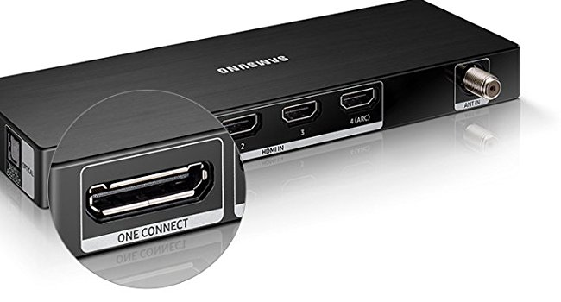
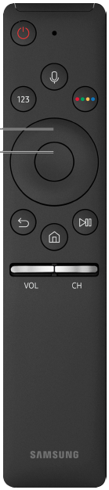
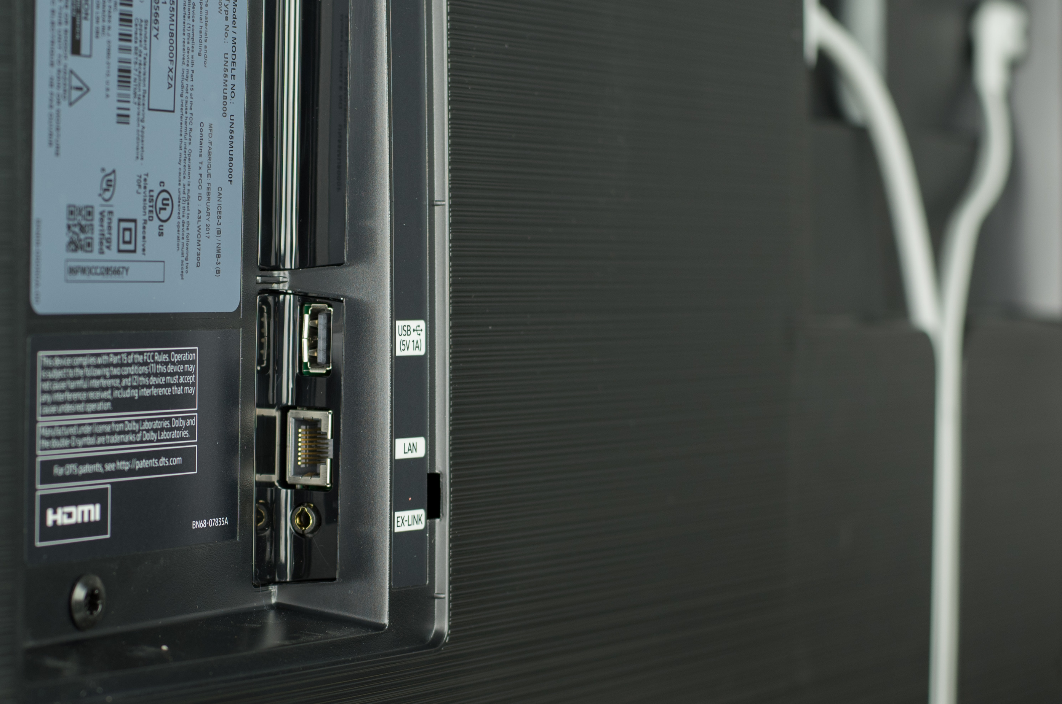
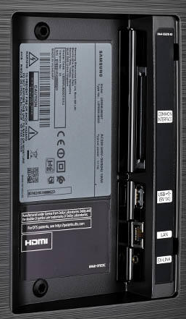
TV Connections
USB 1
USB 2
Audio
Optical
HDMI 1-4 RF Ant
Connect Box
Power
Ethernet

Slide 5
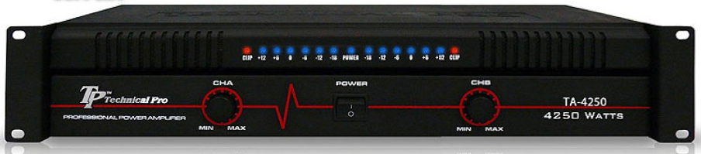
PA System Instructions
Power AMP
Left
Power
Right
Examine speakers to ensure they are safely attached
Open Credenza doors to ensure equipment does not overheat
Turn on as needed TV & DVD, then PA Power Strip, then Power AMP
Ensure all devices are powered on
Use Power AMP to control ROOM Volume
Left and Right Volume Must Match, turn down to 9 o’clock when done
If needed see detailed settings in the following pages
When done turn off All power including Power AMP
CAUTION DO NOT use microphones closer than 15 feet to speakers

Slide 6
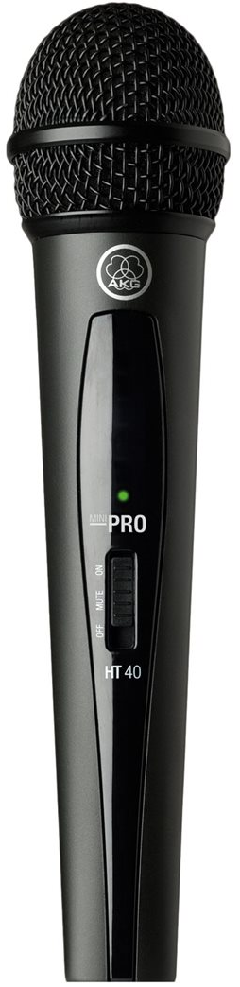
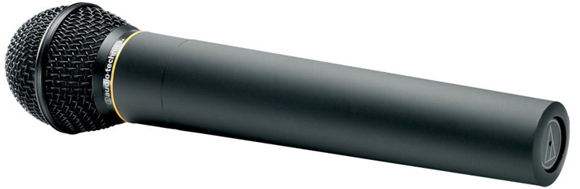
Microphone Use
If no sound go to details
SR 40 PRO 2 Microphone 1 & 2 (use these first)
  Slide switch up on mic for on and verify light goes on at receiver
  If light fails to go on or goes on then off replace batteries
  If needed adjust volume on power AMP
  Slide mic switch down for off, verify light goes off at receiver
Audio Technica Mic A (use only if needed & see wired mic)
  Verify Mic A volume is set properly (see detailed instructions)
  Press button at bottom of mic until light goes on at receiver
  If light fails to go on or goes on then off replace batteries
  If needed adjust volume on power AMP
  Press button again to turn off mic, verify light goes off at receiver
Wired Mic
  When not using set its volume to 0 or turn off mic switch on Numark
  If using Mic A then remove wired mic from cabinet & place near users
Turn off MICs when done or batteries will fail

Slide 7
Entertainment Use
If no sound go to details
TV or DVD (turn on TV, if needed DVD, and then PA)
  Turn down TV speakers to 1, 2, or 3 (too much echo)
  If needed adjust volume on power AMP
CD 1 or 2 (turn on PA)
  On Numark select CD 1 and or 2 switch and press play
  If needed adjust volume on power AMP
  When done switch CH 1 & 2 to Phono / Line so TV & DVD work
External device - computer MP players (turn on PA)
  Find cable quick disconnect near center of hutch
  Find external device cable near center of hutch
  Disconnect cable from DVD and connect external device cable
  If needed adjust volume on power AMP
  When done reconnect DVD player so DVD works

Slide 8
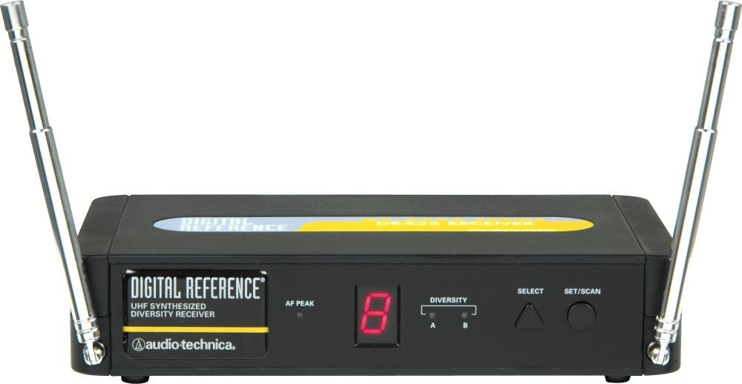
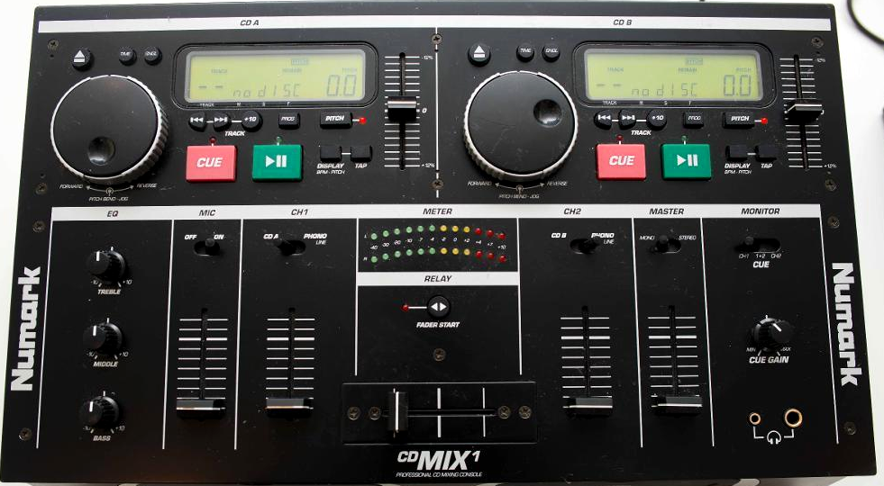
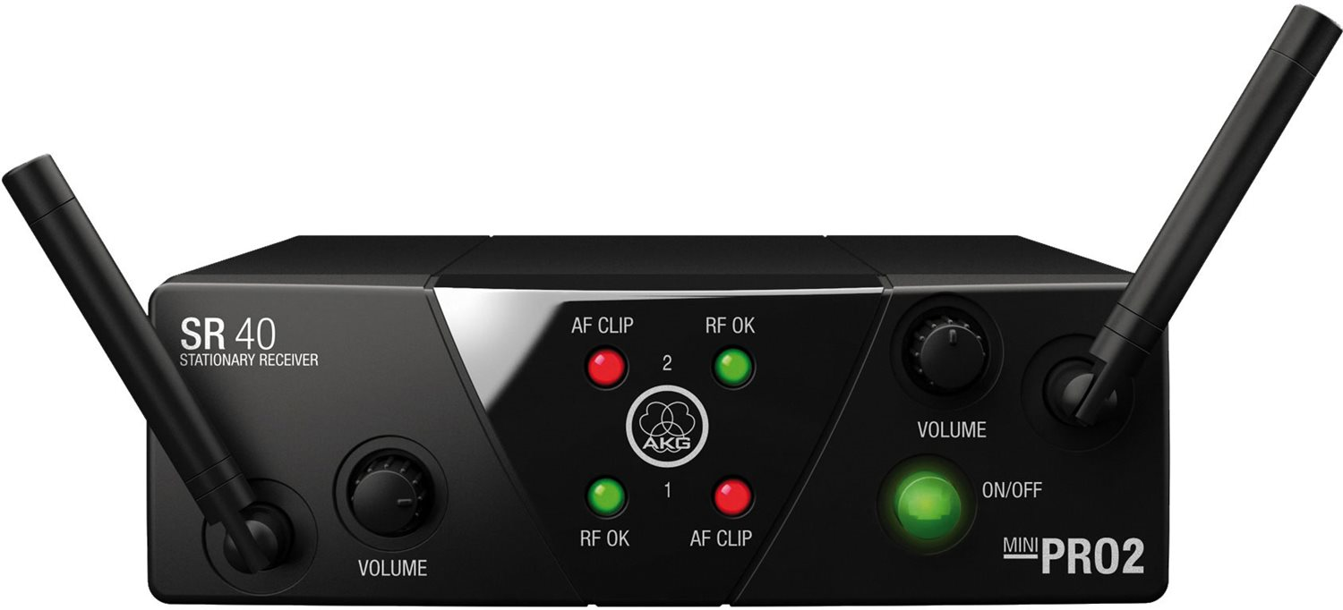
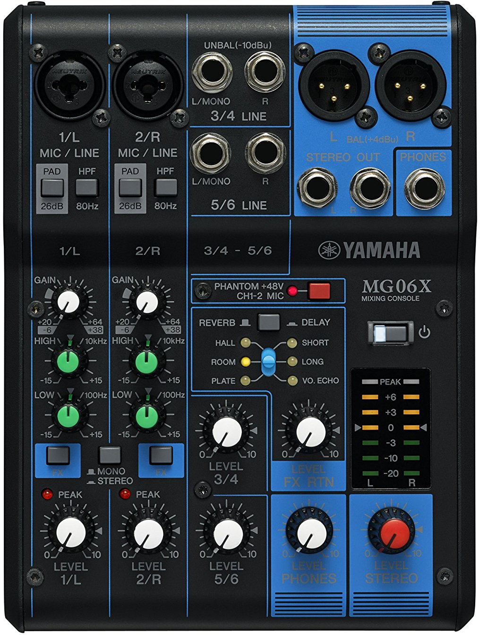
System Configuration
TV
DVD
External 1
Cables
TV to Numark: RCA-RCA
DVD To Numark: RCA-RCA female link (2) RCA-RCA
External 1: RCA-mini stereo male
External 2: None
Numark to YAMAHA: RCA-RCA RCA-Phone Plug (2)
Wired Mic to Numark: XLR-XLR (1) Y-XLR (1)
Wireless Mic A to Numark: XLR-XLR (1)
Wireless Mic 1 & 2: XLR-XLR (2)
YAMAHA to AMP: XLR-RCA (2)
Wired Mic
Quick Disconnect Cable
CH1
CH2
Mic
Wireless Mic A
Numark
Wireless Mic 1
Wireless Mic 2
AMP
External 2
Speaker L
Speaker R
YAMAHA

Slide 9
Volume Controls
USE AMP TO CONTROL ROOM VOLUME
Left
Right
Mic 1 Mic 2
Wireless
Master
Wired Mic
Wireless Audio Technica Mic A
CD1 or
TV
Center
CD2 or
DVD
Master
CAUTION - Wired Mic is a source of serious feedback when left in cabinet. Set volume to 0 or switch off or use wired Mic. Yes Wireless Audio Technica Mic A is tied to wired Mic.

Slide 10



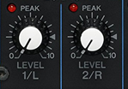
Volume Adjustments
TV
  Adjust using Numark CH 1 Slider
  Usually on at 50%
DVD
  Adjust using Numark CH 2 Slider
  Usually on at 50%
Microphone Wired & Audio Technica Wireless
  Adjust using Numark Mic Slider
  Usually off at 0 because of wired mic, on is 50%
Microphones SR 40 PRO 2
  Preset using YAMAHA Mixer Mic Level 1 & 2
  Adjustment not needed

Slide 11
Room Equalization Settings
System has some frequency equalization abilities
  To deal with room and less than optimal installations
  Current settings must not be changed significantly
Numark Settings:
  Treble +10 Max
  Mid about 1 o’clock
  Bass about 3 o’clock
YAMAHA Settings:
  High +15 DB
  Low about 2 o’clock
Room Echo
  The only way to reduce room echo is to change speaker location

Slide 12
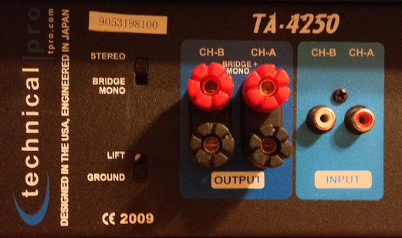
Power AMP
USE THIS TO CONTROL ROOM VOLUME
CH A & B must match: 9 to 11 o’clock
Input
CH A & B from
YAMAHA Mixer
Stereo
Output
Speakers Polarity
Must Match
Lift
Caution: Do Not bridge. This can damage the speakers with excessive power.

Slide 13
NUMARK CD Mix 1
Input Mic: Wired & Audio Technical
Input CH 1: TV Cable Box
Input CH 2: DVD or external device
Output: YAMAHA Mixer
Treble +10 max
Mid 1 o’clock
Bass 3 o’clock
Adjust so Meters are Full Green
Mic On
Mic: 50%
TV
Phono
Ch1: 50%
Fader
Center
DVD
Phono
Ch2: 50%
Stereo
Master 60%
1+2
Gain 0
For CD1 or CD2 select using the CH1 or CH2 switch

Slide 14
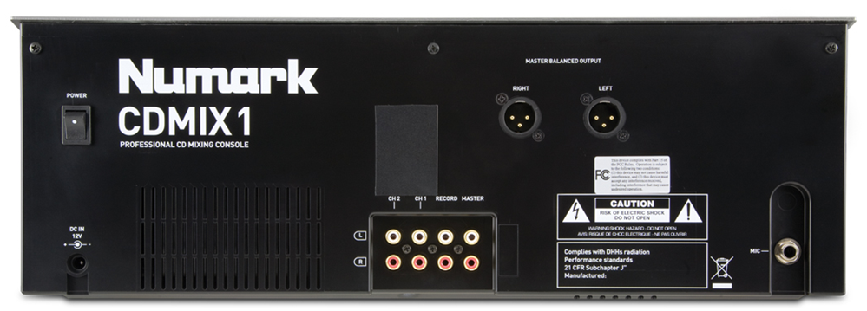
NUMARK CD Mix 1
CH1: TV Cable box
CH2: DVD or External Device
MIC: Wired & Audio Technica Wireless
Master: YAMAHA Mixer

Slide 15
MICs From
SR40 PRO 2
From Numark
CD Mix 1
To
Power AMP
1/L & 2/R Settings MUST match
YAMAHA
Mixer
PAD 1 Up
PAD 2 Up
HPF1 Down
HPF2 Down
Red Button
Phantom Up for OFF
Gain 12 o’clock
High +15 DB o’clock
Low 2 o’clock
Power on / off
Fx1 Down ON
Fx2 Down ON
Mono / Stereo UP
Meter Set -3DB all devices
Start with TV
Master Volume 3 o’clock
Headphones 0
Mic Level 1 2 o’clock
Mic Level 2 2 o’clock
Level 3/4 2 o’clock
Level 5/6 0 Not Used
Fx Return Level 11 o’clock
Delay Down, VO. Echo

Slide 16
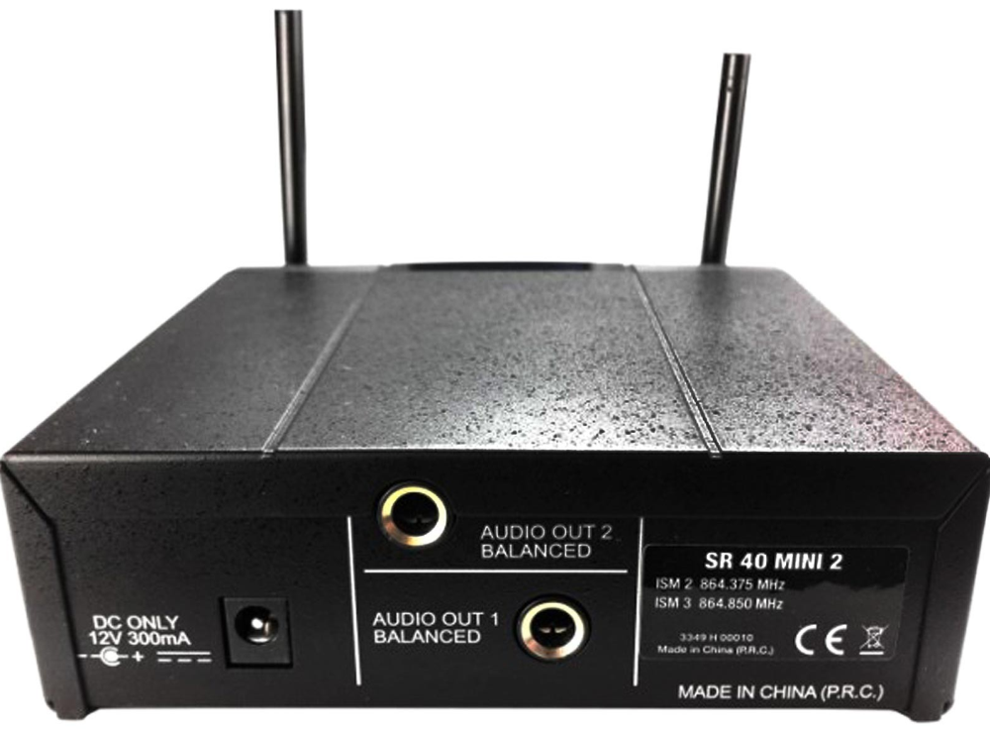
SR 40 PRO 2 Microphone 1 and 2
Goes to YAMAHA Mixer 1/L and 2/R
Power on/off
Level 1 - 12 o’clock
Level 2 - 12 o’clock
Level 1 and 2 settings must match
On
Mute
Off
MIC has slide switch, Up is on Down is off
If green light does not go on and stay on with MIC on, replace batteries
Turn off MIC when done
YAMAHA 2/R
YAMAHA 1/L

Slide 17
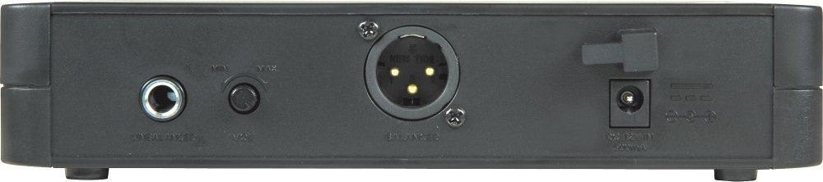
Audio Technica Microphones A and B
Goes to NUMARK CD Mix 1 MIC input
Push Power
MIC has button on bottom, press on press off
If diversity A or B light does not go on and stay on with MIC on, replace batteries
Turn off MIC when done
To NUMARK CD Mix 1

Slide 18
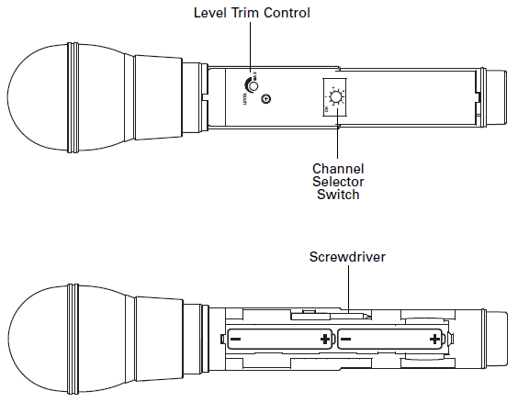
Audio Technica Microphones A & B

Slide 19
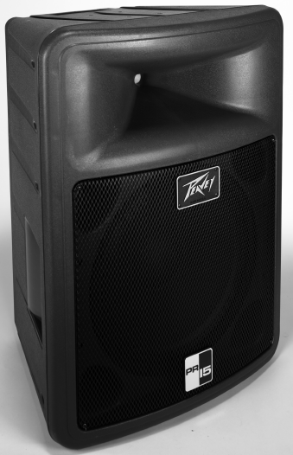

Speakers

