Slide 1
Entertainment Center Instructions
June 2022

Slide 2
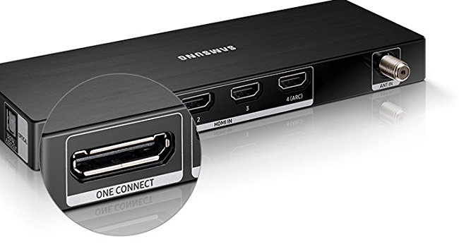
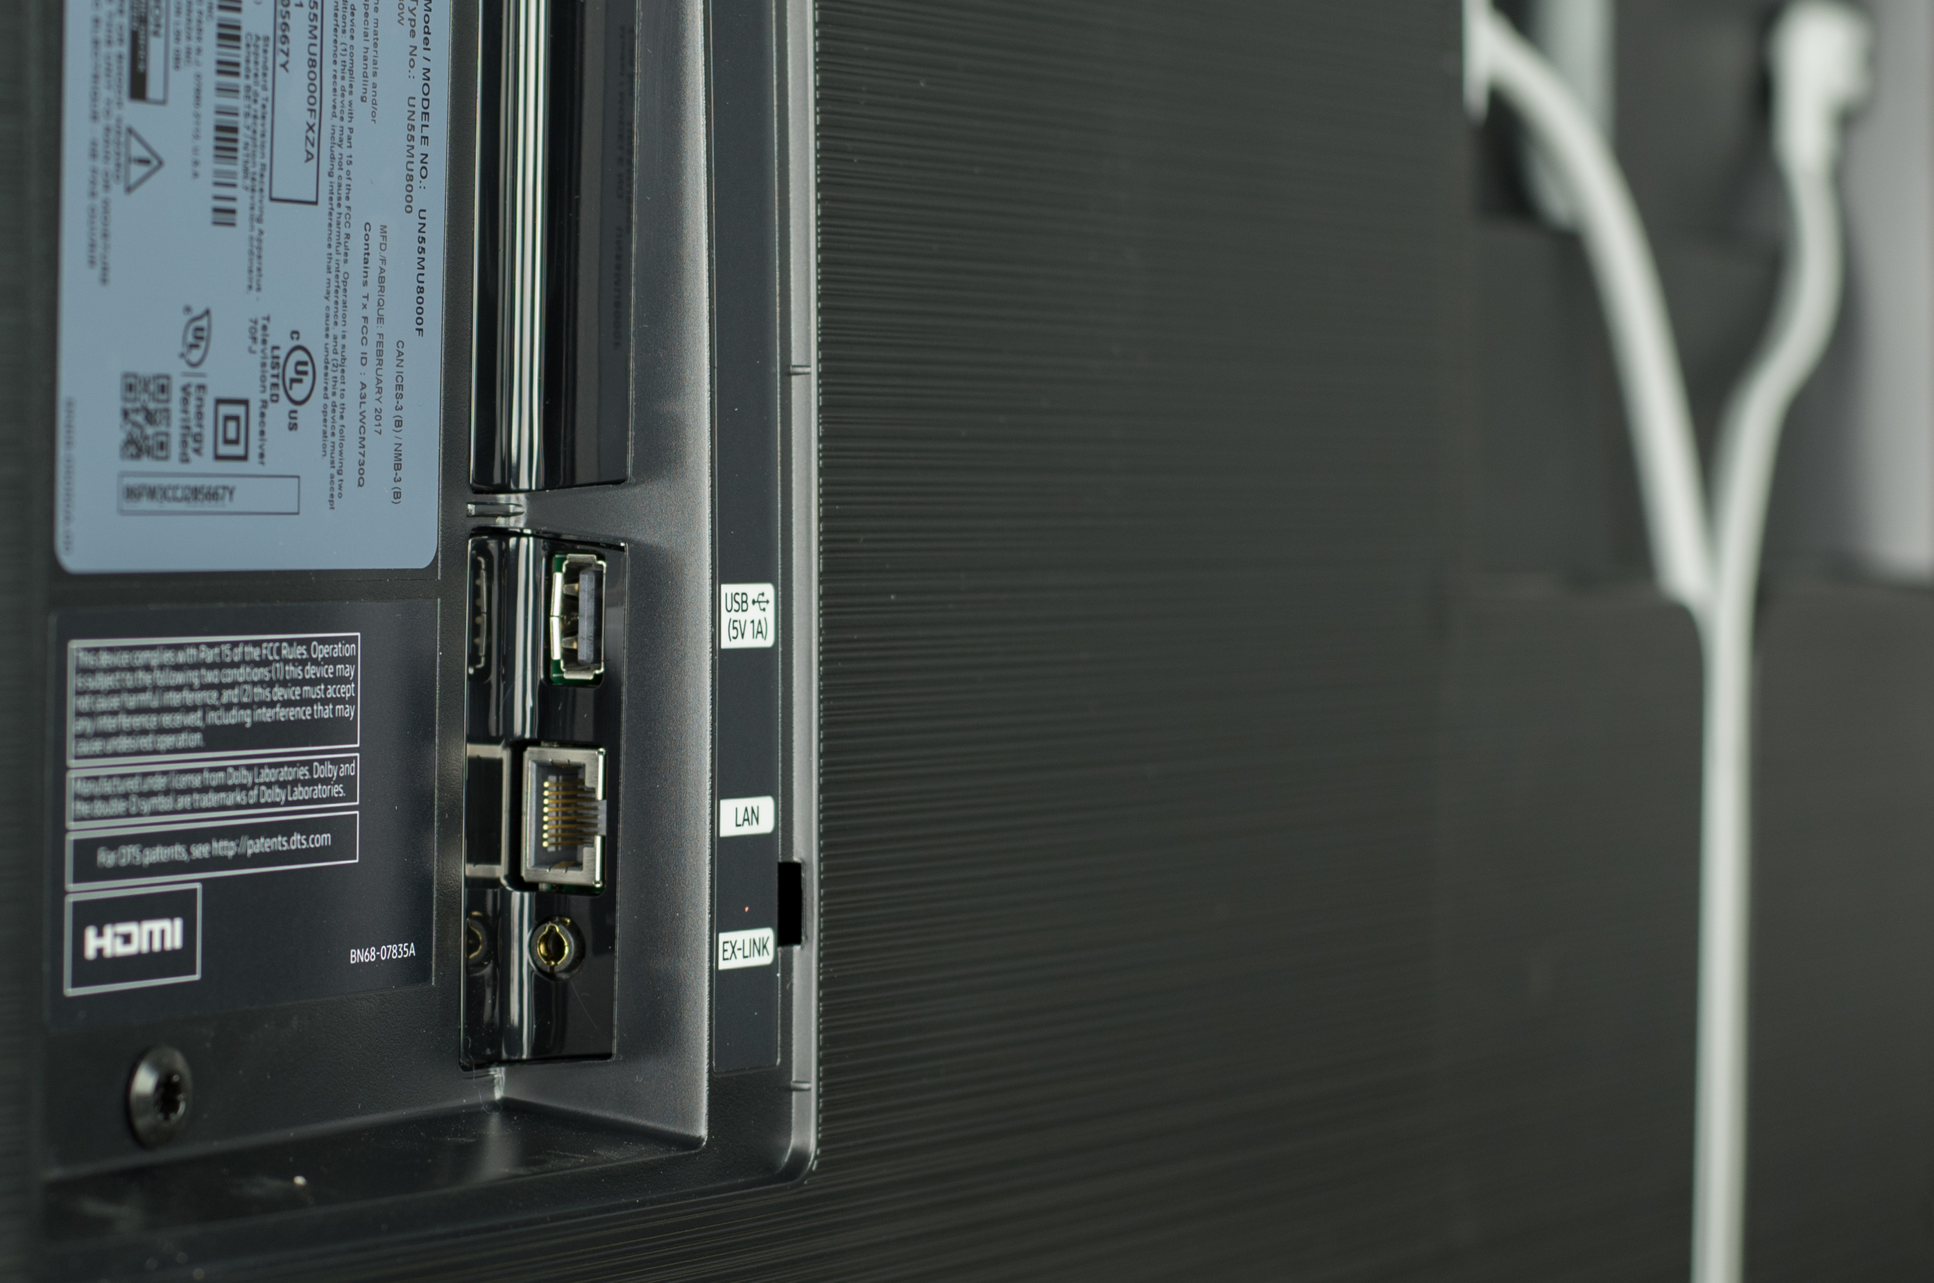
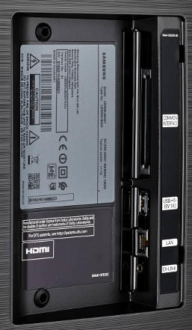
TV Connections
USB 1
USB 2
Audio
Optical
HDMI 1 Cable
HDMI 2 DVD
HDMI 3 PC
HDMI 1-4 RF Ant
Connect Box
Power
Ethernet

Slide 3
PA System Instructions
Power AMP
Left
Power
Right
Examine speakers to ensure they are safely attached
Open Credenza doors to ensure equipment does not overheat
Turn on as needed TV & DVD, then PA Power Strip, then Power AMP
Ensure all devices are powered on
Use Power AMP to control ROOM Volume
Left and Right Volume Must Match, turn down to 9 o’clock when done
When done turn off All power including Power AMP
CAUTION DO NOT use microphones closer than 15 feet to speakers

Slide 4
Wireless Microphone Use
Shure BLX2/PG58
Unscrew Bottom
Press Power Button
Select channel and Group to match Channel and Group on receiver in cabinet
Look at receiver battery light & make sure it is green or replace batteries
Use rechargeable batteries because they only last for 1 or 2 meetings
Turn off MICs when done or batteries will fail

Slide 5
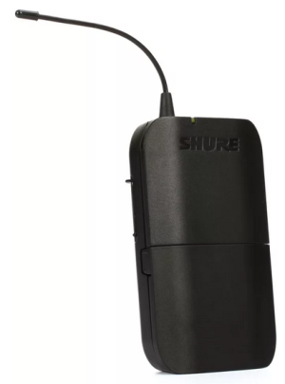
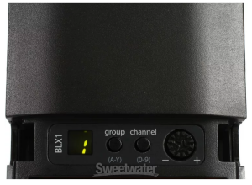
Wearable Microphone Use
Shure BLX1
Press Power Button at top
Open compartment
Select channel and Group to match Channel and Group on receiver in cabinet
Look at receiver battery light & make sure it is green or replace batteries
Use rechargeable batteries because they only last for 1 or 2 meetings
Turn down volume to stop feedback
Volume
Turn off MICs when done or batteries will fail

Slide 6
Microphone Use Receiver
Microphones must connect to receiver using the correct Group and Channel
There are 2 receivers, 1 for each Mic
Use Receiver # 2 for the wearable wireless mic
They are always on

Slide 7
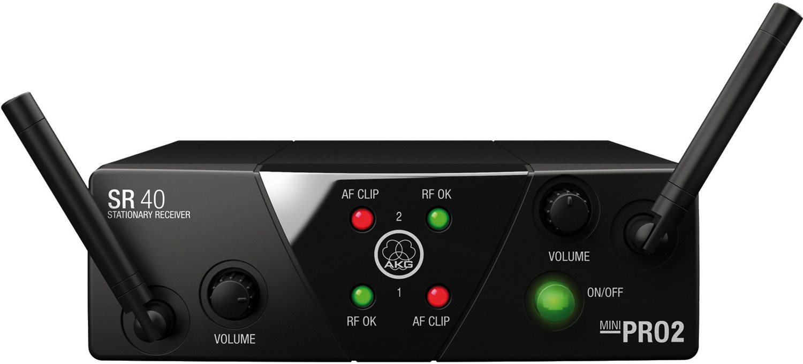
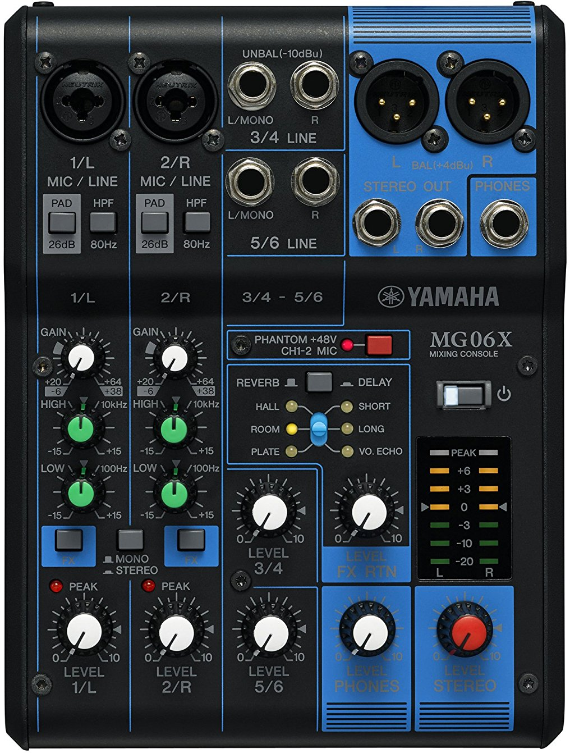
System Configuration
Wired Mics
DVD
Wireless Mic 1
Wireless Mic 2
AMP
External 1
Speaker L
Speaker R
YAMAHA

Slide 8
Volume Controls
USE AMP TO CONTROL ROOM VOLUME
Left
Right
Wireless
Mic 1&2
Wired
Mics
Master
DVD

Slide 9
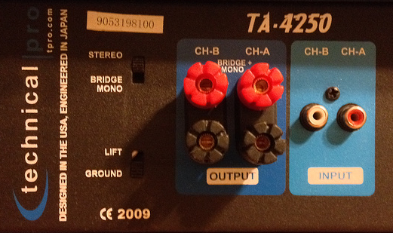
Power AMP
USE THIS TO CONTROL ROOM VOLUME
CH A & B must match: 9 to 11 o’clock
Input
CH A & B from
YAMAHA Mixer
Stereo
Output
Speakers Polarity
Must Match
Lift
Caution: Do Not bridge. This can damage the speakers with excessive power.

Slide 10
Wireless
MICs
From DVD
To
Power AMP
1/L & 2/R Settings MUST match
YAMAHA
Mixer
PAD 1 Up
PAD 2 Up
HPF1 Down
HPF2 Down
Red Button
Phantom Up for OFF
Gain 12 o’clock
High +15 DB o’clock
Low 2 o’clock
Power on / off
Fx1 Down ON
Fx2 Down ON
Mono / Stereo UP
Meter Set -3DB all devices
Start with TV
Master Volume 3 o’clock
Headphones 0
Mic Level 1 2 o’clock
Mic Level 2 2 o’clock
Level 3/4 2 o’clock
Level 5/6 0 Not Used
Fx Return Level 11 o’clock
Delay Down, VO. Echo

Slide 11
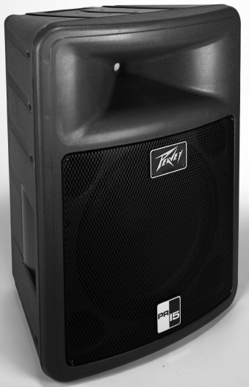
Speakers

Slide 12
Sound System Power Turn off when done!

