Slide 1
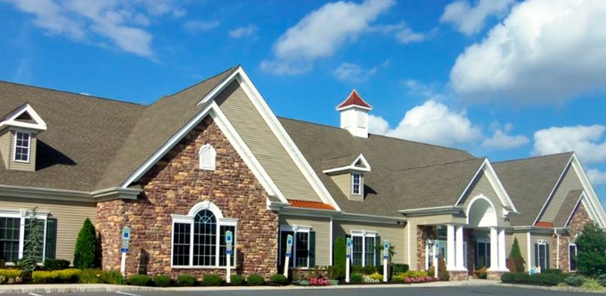
Village Grande at English Mill
Website Introduction
March 2025

Slide 2
Why A New Website?
There are Needs that should be fulfilled
The board needs some tools
Email
Document repository
Quality Assurance and Management
The residents need a better experience
Communications
Finding information
Getting involved
Potential owners need to see why they should move here
New owners need to learn about our community

Slide 3
Why Should I Use The New Website?
All Events and Announcements are on 1 webpage
Sorted by date
Clear fields for name, date, and description
Flyers and Documents have links
Links work immediately without logging into another place
It is easy to read
Black text white background
Properly sized font
Sans Serif font (Times New Roman) so that letters are legible
Not constantly interrupted with emails containing same info
Does not displace existing systems (paper, clubhouse, etc.)
There are new services available to enhance our community

Slide 4
Big Picture
This is a Big Deal!
Everyone's property value increased
New residents don’t know life without the Internet
Blue Heron Pines website established 2003
Village Grande Little Mill website established 2010
Does not replace Paper or TownSq / Volos systems
It’s for the residents by the residents
Provides tools to the HOA
Email
Document repository
Communications and Trouble Reports

Slide 5
Big Picture
We are a nonprofit => .org
Domain name extremely valuable
If it lapses it will cost thousands to get it back
Looking for new WebSite Committee members
Everyone is welcome
You do not need to be technical
Anything you can imagine is possible
Meetings are Mondays’ 7 PM

Slide 6
Costs
Domain name ~$50/year
Web hosting company ~ $20-$30/month
Work done by website committee - free

Slide 7
How was this done so fast?
Website built in 2017
Interacted with Jim
Website concept rejected by board in 2018
No reasons given
Started with 2017 baseline
Added content from TownSq
Added content from email announcements
Moved links on right to page bottom for smartphones

Slide 8
How is the Website Updated
TownSq & Volos announcements placed on website
Messages
PDF files
Flyers
When other content arrives via email, placed on website
Messages
PDF files
Flyers

Slide 9
Need Info for Updates
VGEM News (need some missing issues)
Old Gazette (need some missing issues)
Directory is 2023, needs to be updated ASAP
Finance
Need to update 2017 figure on webpage
Some budgets are missing
Looking for authors for New Online Grande Gazette
Looking for new staff volunteers
Looking for Price Plus Club to provide venders
Looking for photographer(s)

Slide 10
Privacy
This is at the bottom each webpage
This information is intended only for the Village Grande residents and may contain information that is confidential or privileged. If you are not a Village Grande resident, you are hereby notified that any dissemination, distribution or copying of this information is strictly prohibited.
Some areas require login, like the directory

Slide 11
Demo
Show Splash Page
Show Main Page
Show Links top, bottom
Show Committees (website)
Show Policy
Show Resident Directory Access
Show Internet Form entry
Show Database Report
Some areas require login, like the directory
https://www.vgem.org

Slide 12
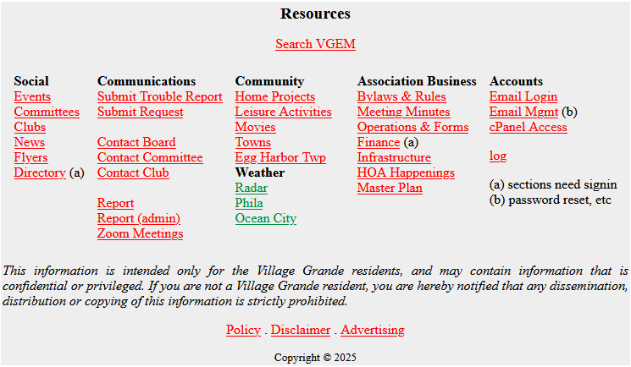
Questions Comments Suggestions

